Slide 1
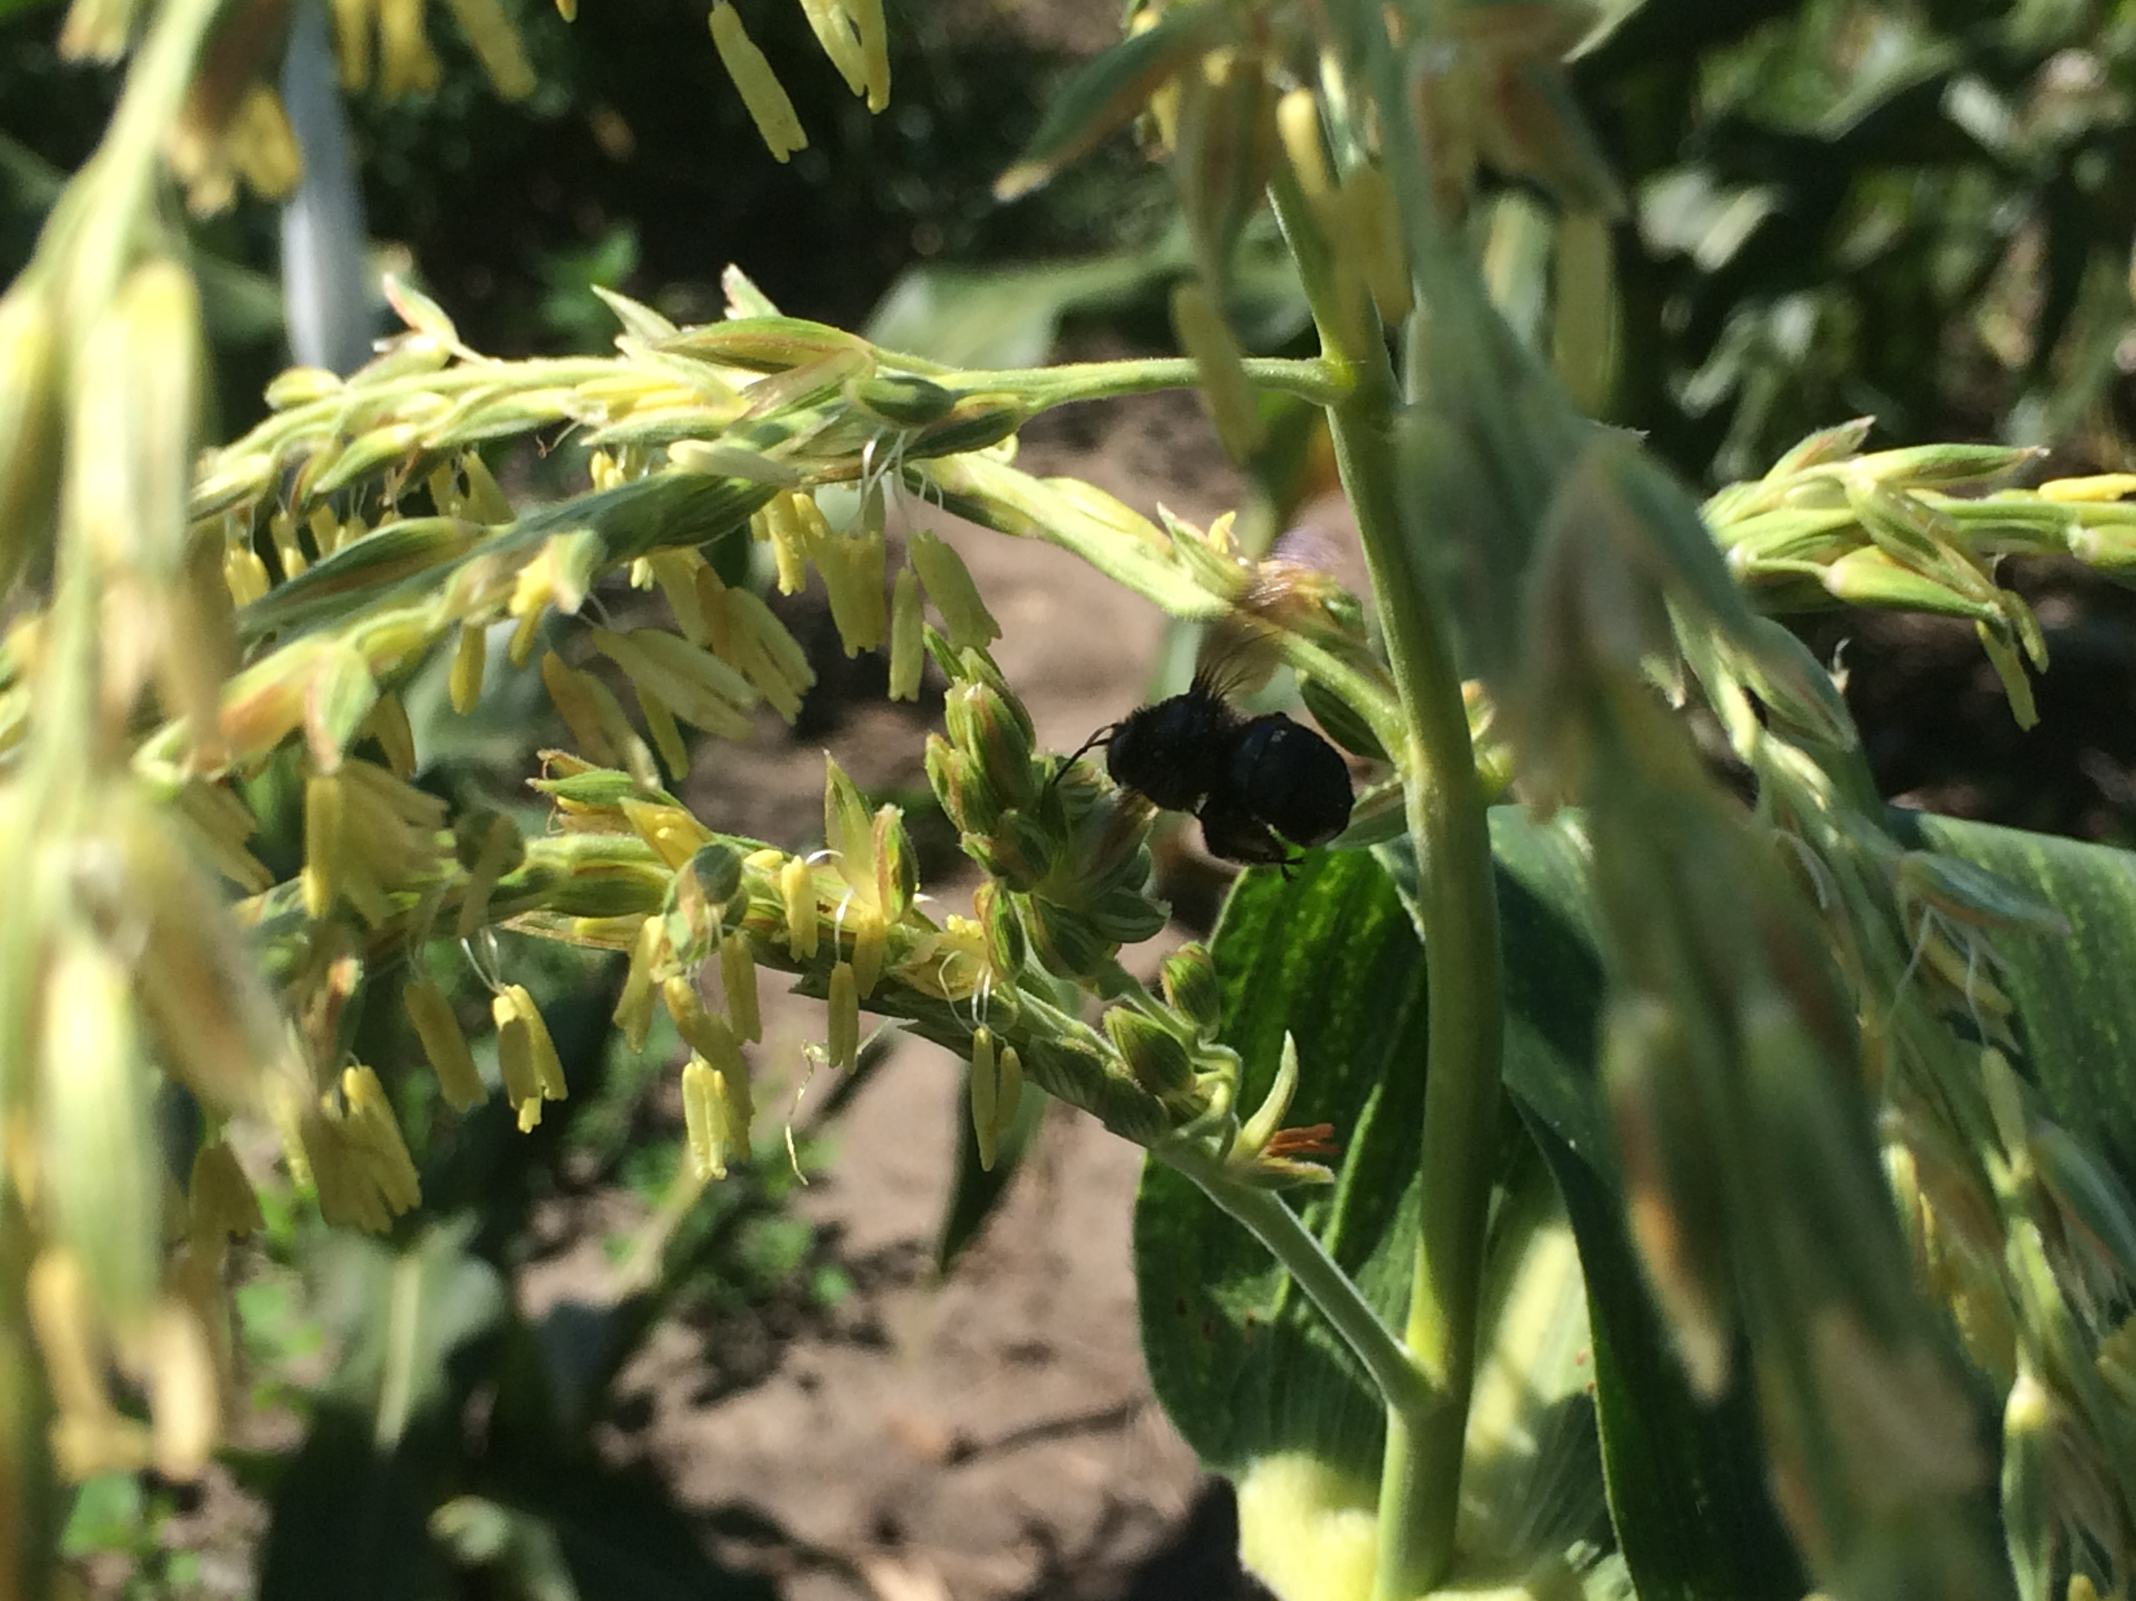


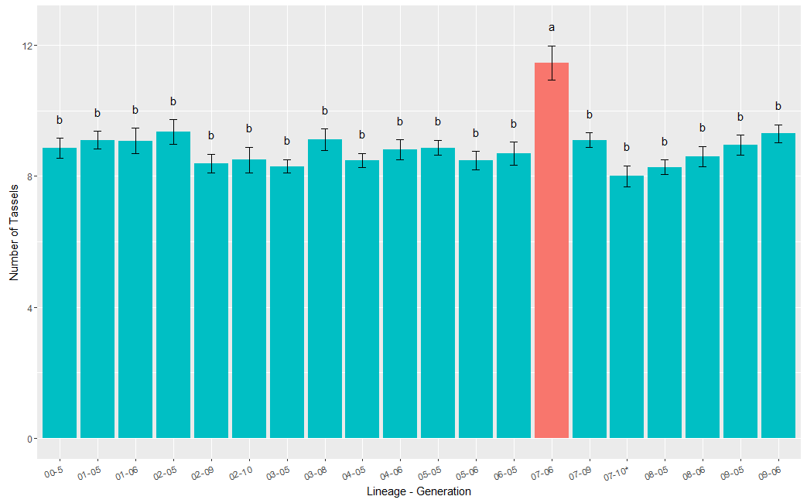
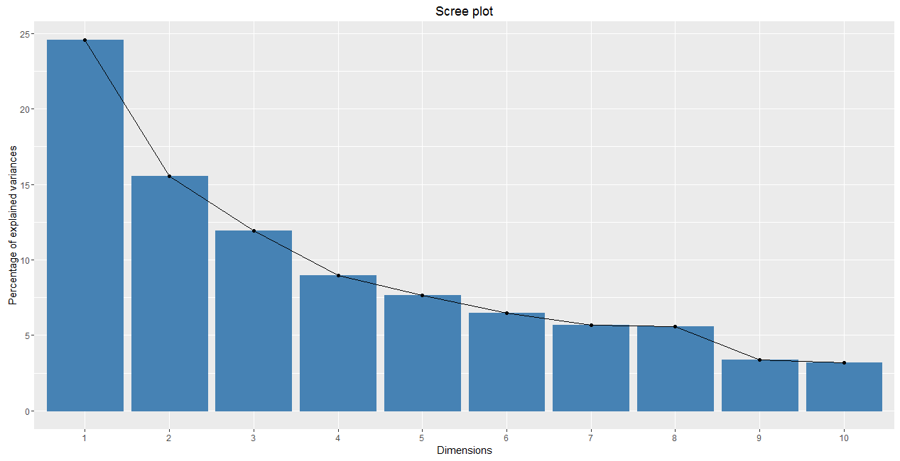
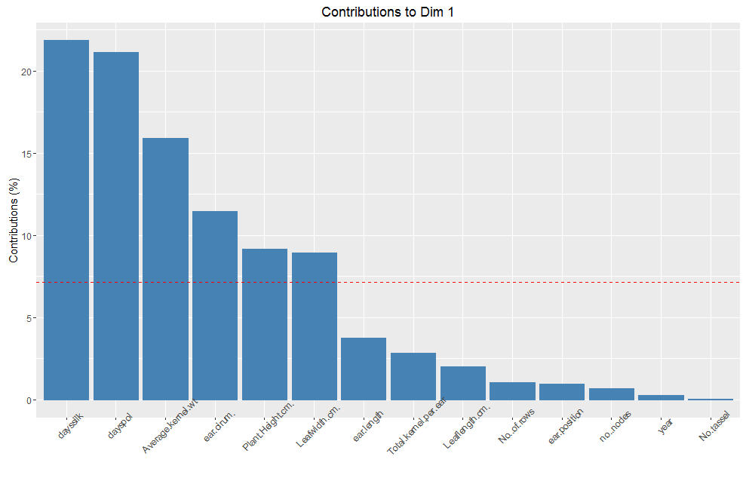
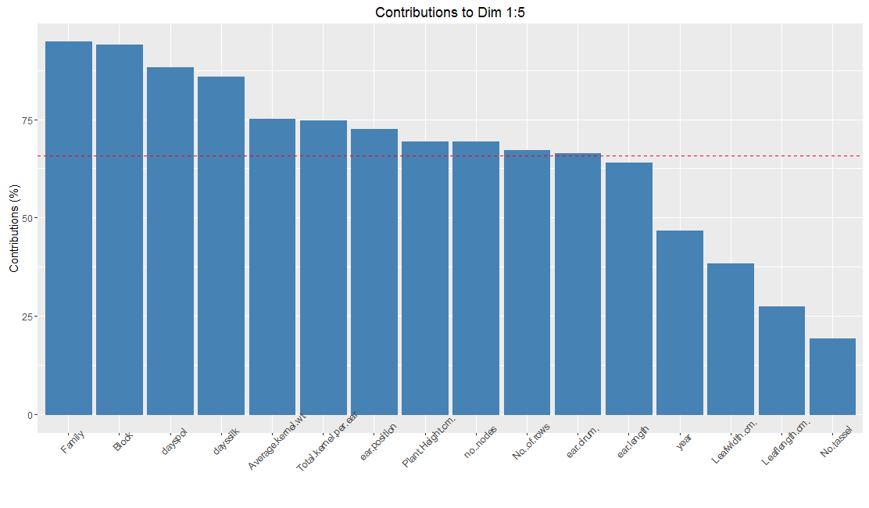
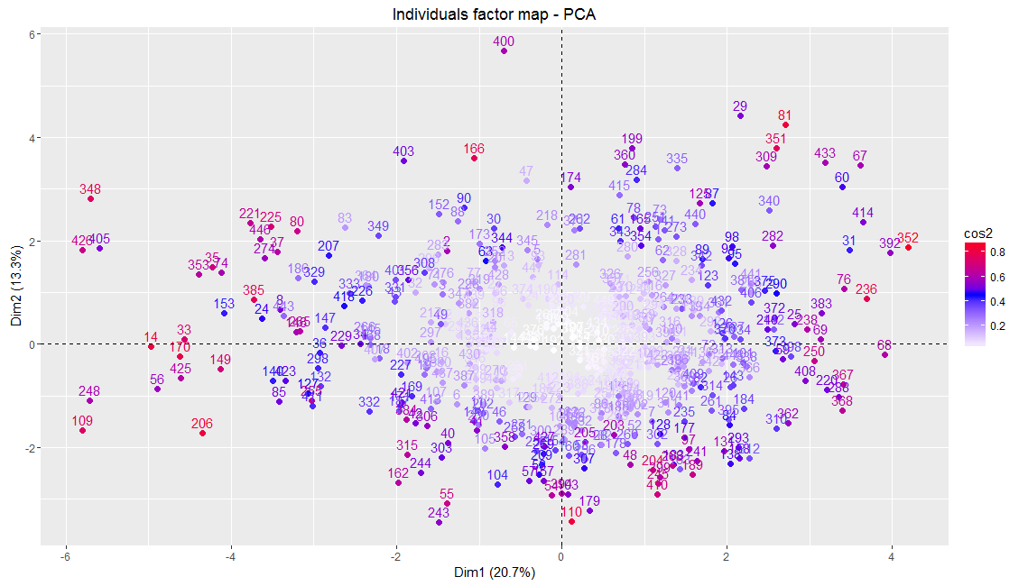
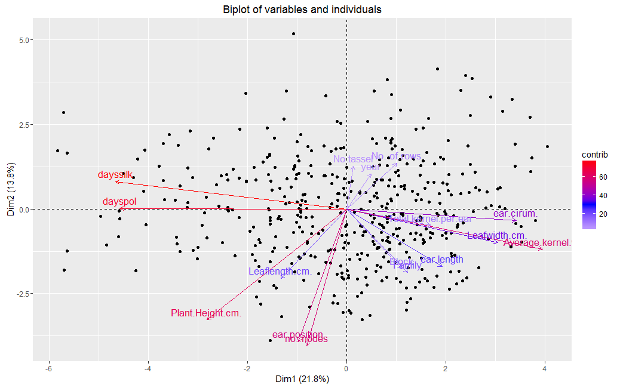
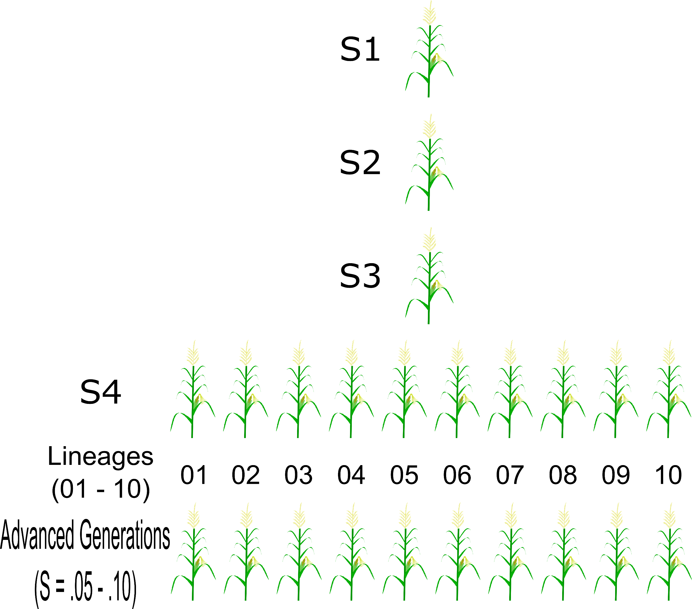

Systemic Analysis of Biological Data from an Isogenic Maize Line
Merritt Bryer Burch, Boris Shmagin, Vivek Shrestha, Donald Auger
Department of Biology and Microbiology, South Dakota State University, Brookings SD 57006, USA
Abstract
Results
Double-haploid plants formed from single-seed descent lines are thought to have no genetic variability
Measuring numerous quantitative traits has shown that additional selfing generations lead to greater phenotypic variability
Finding trends and relationships in large datasets can be difficult to understand, thus, using multivariate analyses to explain biological variabilities and patterns is incredibly useful
Introduction & Background
Doubled-Haploids (DH)
Monoploid plants can chemically or naturally diplodize to create completely homozygous progeny so that both parent and progeny are identical genotypically and phenotypically
Sprauge et al., (1960) showed that genetic variability in doubled-haploid maize increases with continued self fertilization
Genetic variability found proceeded faster than normal rate of mutation, potentially suggesting epigenetic control
DH maize are create inbred lines that are used extensively in breeding programs to create hybrids
Genetic breakdown of inbred-stocks could be detrimental to farmers
Principal Component Analysis (PCA)
PCA is a statistical technique used to summarize systematic patterns of variation into a small number of subsets, called principal components.
These principal components are combinations of our measured traits whose variability explains a majority of the relationships in our data.
These analyses are useful when attempting to explain patterns in a population based on multiple variables, unlike single variable statistical techniques like 1/2-way ANOVAS or mixed effect models.
Fig 2: Barchart depicting the mean and standard error of the number of tassel branches and the lineage-generation. The linear mixed effect model showed that there was a significant relationship between the number of tassel branches and the lineage-generation (F_{19,429}=4.47, p<0.001). Least squared means post-hoc results show significant relationships in lineage-generations that have unique letters. ANOVAs and models, though incredibly useful in finding significant individuals, do not contribute much to explaining the population as a whole.
Fig 3: Scree plot showing the percentage of explained variances and the number of dimensions. The first dimension, or principal component, explains only 22% of the variability in the data. A total of 5 dimensions, equivalent to 67% of the variance would be sufficient in explaining the data. All 16 dimensions explain 100% of the variance.
Fig 4: Barchart showing the percent variance contribution of each of the measured traits to Dimension (Principal Component) 1. Dimension 1 in this dataset accounts for 22% of the variability in the data. The days to silk and pollination, along with the average kernel weight are extremely important in explaining the data while the year and number of tassels is not as important.
Fig 5: Barchart showing the percent variance contribution of each of the measured traits to Dimensions (Principal Component) 1 through 5. Dimensions 1-5 account for 67% of the variance. The field family, block, and the days to silk and pollen shed are the most important in explaining the data, while the leaf length and number of tassels are not as important.
Materials and Methods
Fig 5: A factor map showing the relative importance (see heatmap) of each individual in the first two dimensions of the PCA. Theoretically, all 16 dimensions on our PCA can be plotted in a infinite-dimensional space (Hilbert Space) but, interpretation would be difficult. In this map, no true clustering is observed, potentially due to this data being collected on DH plants.
Fig 6: A biplot displaying our traits and individuals and the relative contribution (see heatmap) of our traits in explaining the total variance in our dataset. This biplot shows the relationships between all our variables, where positively correlated variables are grouped together, negatively correlated variables opposite sides of the plot origin, and the distance between variables measures their quality in the first two dimensions of the PCA.
Conclusions
Future Work
Fig. 1: A single seed descent line created from a B73 doubled-haploid plant were continuously selfed to create ten DH lineages. These lineages were further selfed to create the advanced generations
Biplots showed that days to silk and pollen emergence, average kernel weight, field family, and block were the most important in explaining our data
Reduction of our dataset to these few traits for future analyses would be worthwhile to explaining patterns in our DH population as a whole
Explaining individual lineages, however, and their heritable changes in advanced selfing generations might not stand out in PCA or other multivariate analyses.
No clustering of individuals within traits is observed in Fig 5 & 6, suggesting that our DH data may be too similar to find any large differences
Perform RNAseq on lineages that show significant, heritable changes in quantitative traits to determine potential epigenetic influence on DH genomes
Do PCA on partial study replicates from 2015 and 2016
Look into cluster analysis of our traits and lineages
In the summer of 2014 all ten lineages, with two or more generations were grown at SDSU in randomized blocks
A total of 13 quantitative traits were measured in the DH populations: number of tassel branches, plant height, number of nodes, average kernel weight, days to silk emergence, etc..
The data was then log transformed, centered, and scaled before PCA.
Data visualization and analysis was performed in the stats and factoextra packages in R Studio (V: 3.3.1)
Acknowledgements
Doubled-haploid plants were produced by Akio Kato and provided by Jim Birchler (University of Missouri)
This research was funded by the SDSU Agriculture Experiment Station

